Slide 1

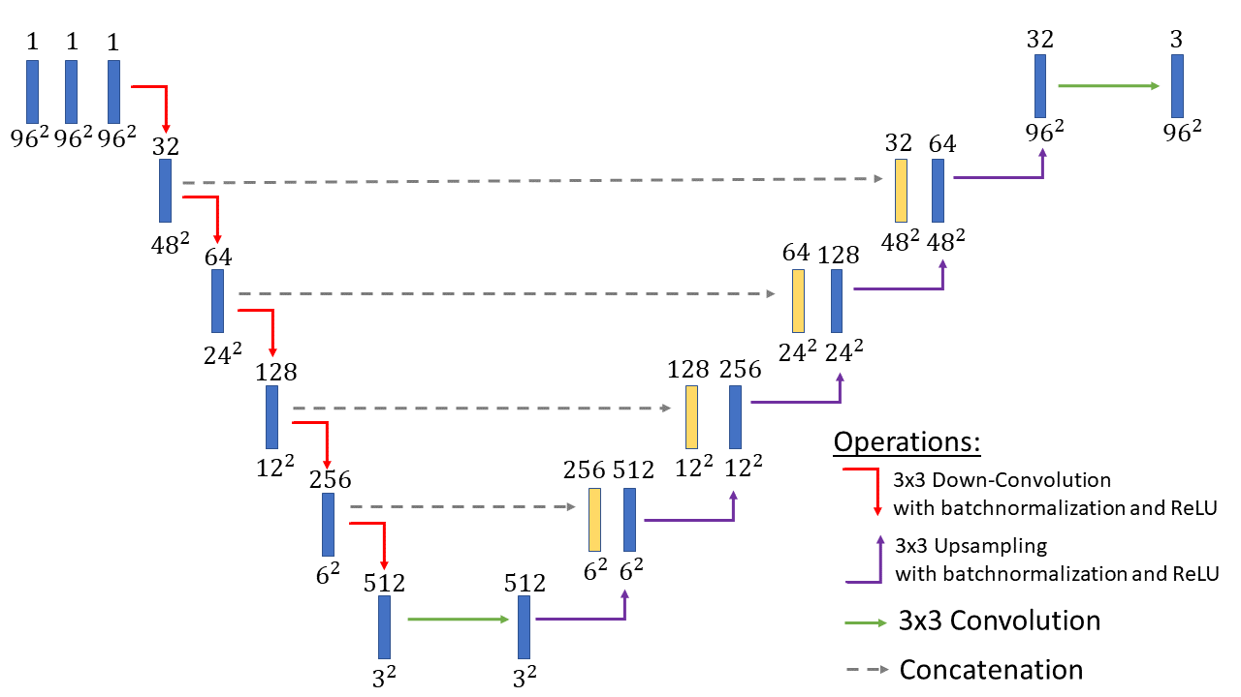
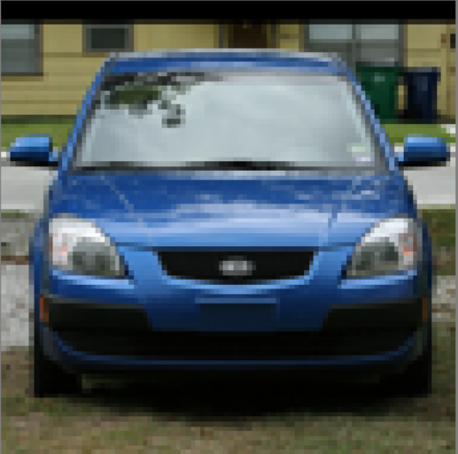
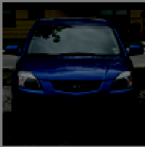
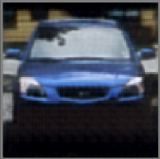
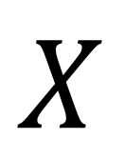
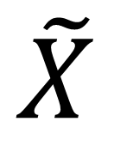
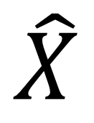
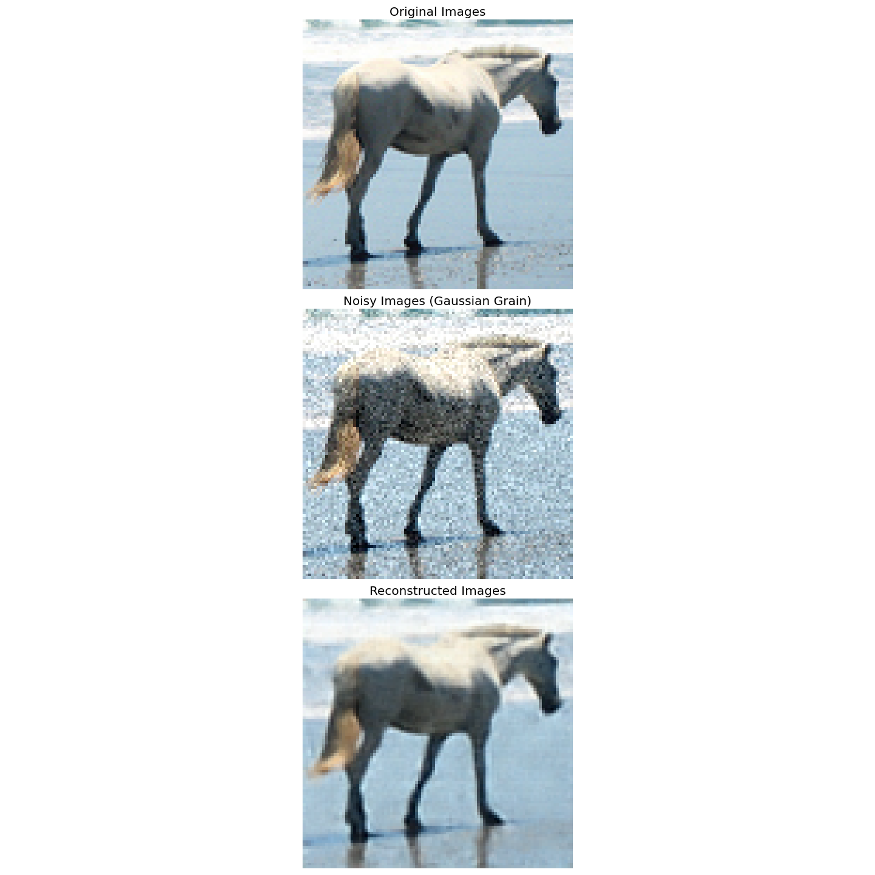
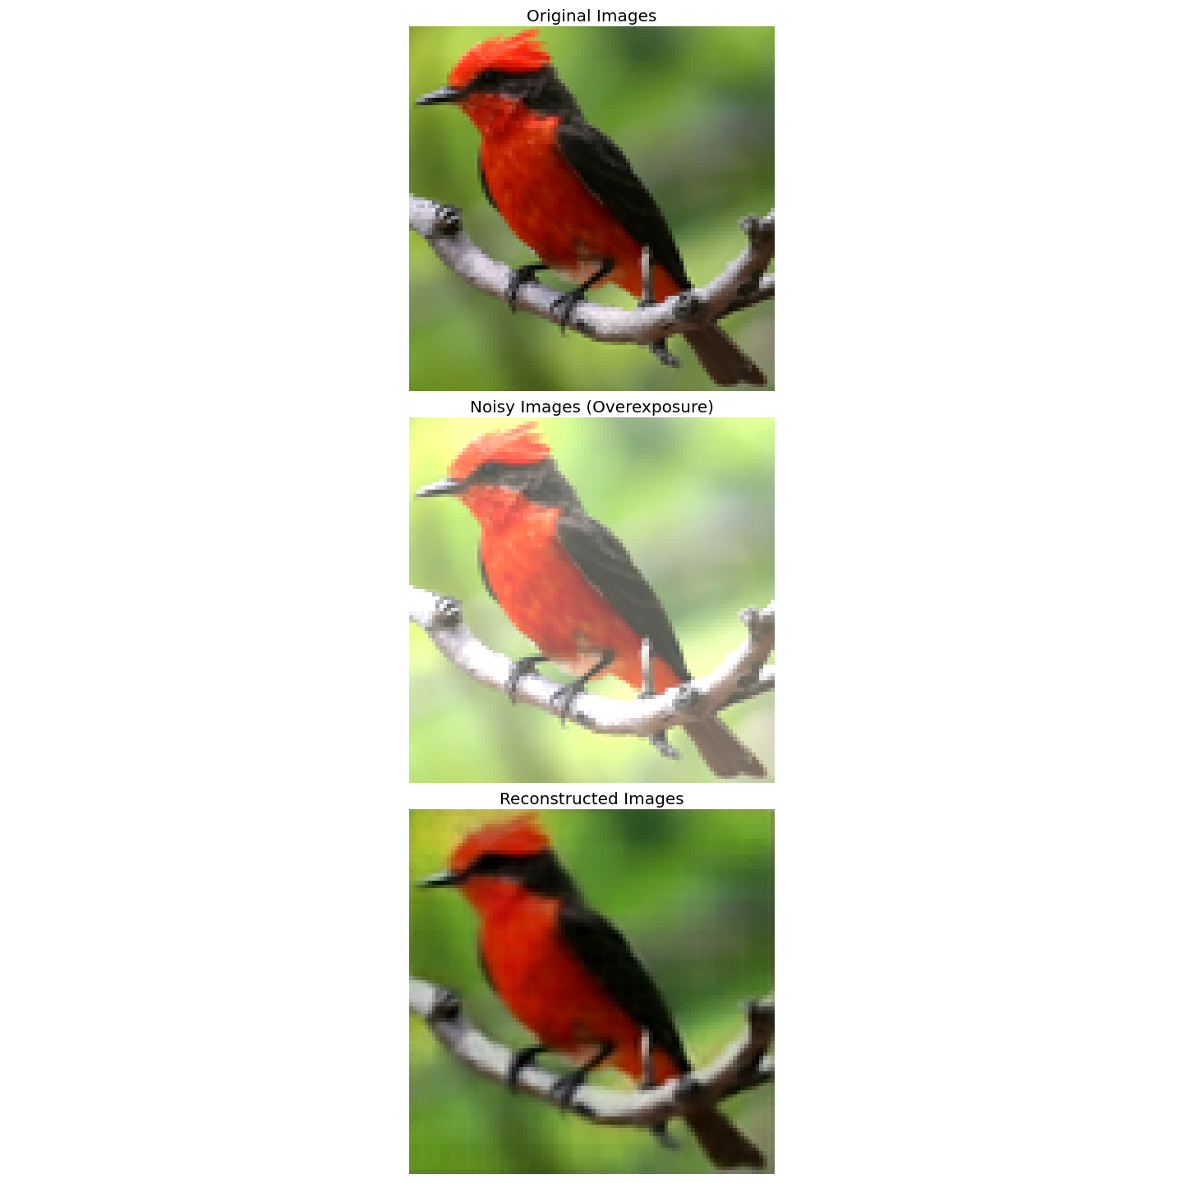
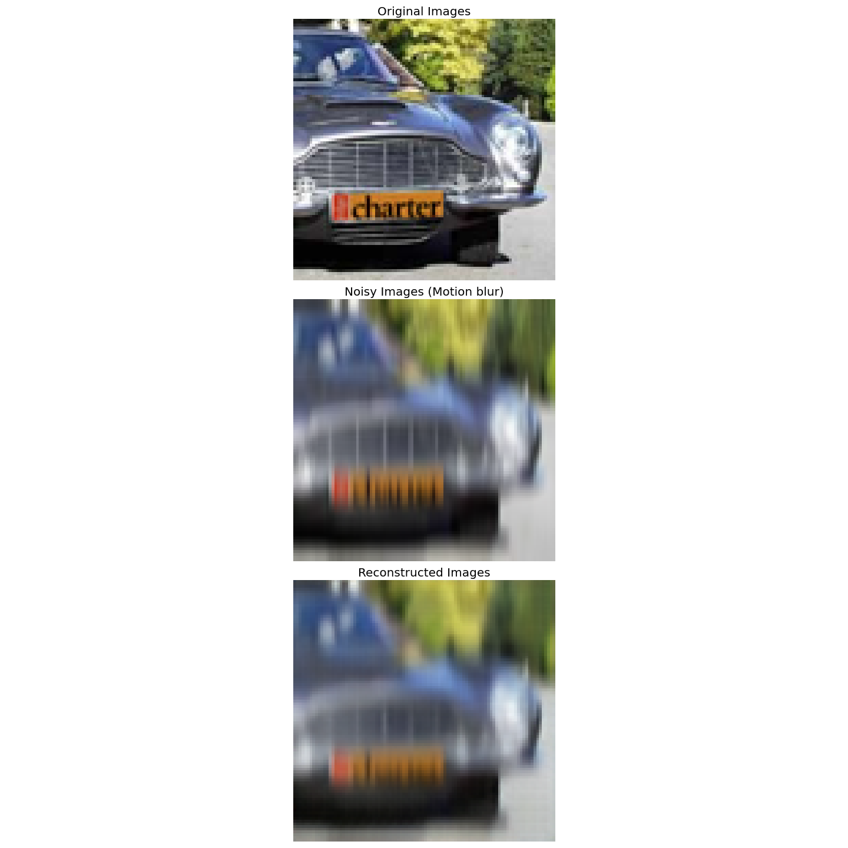
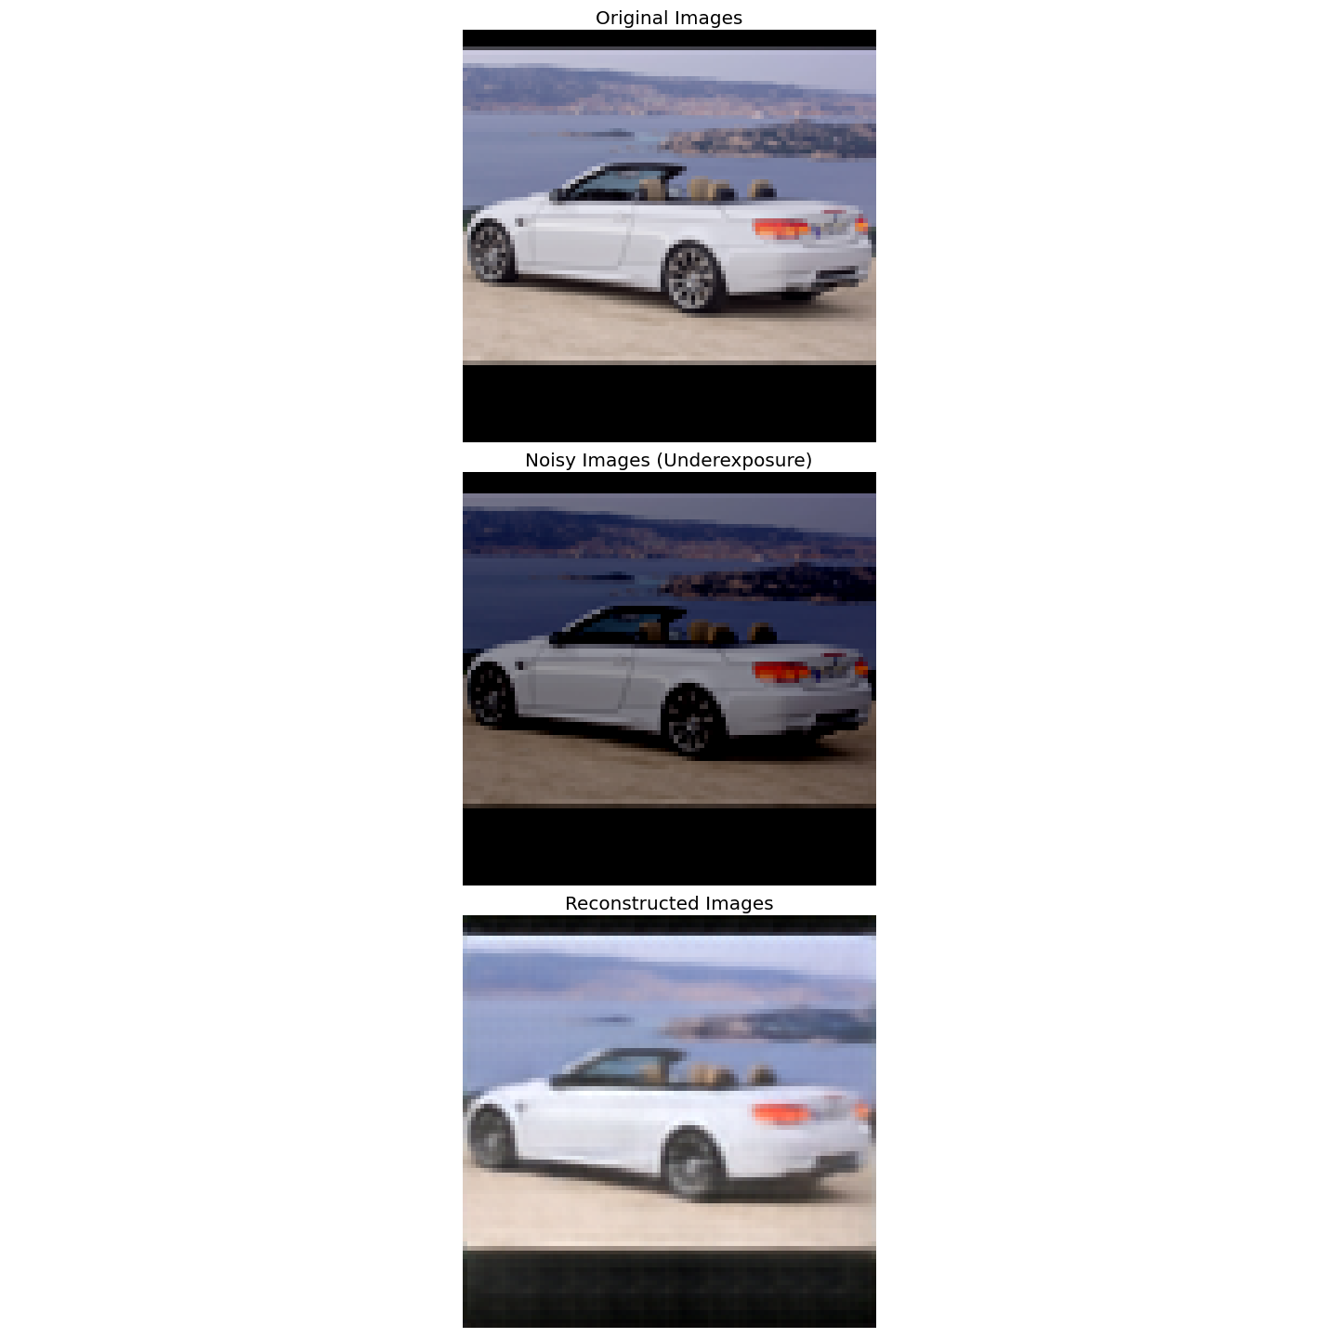
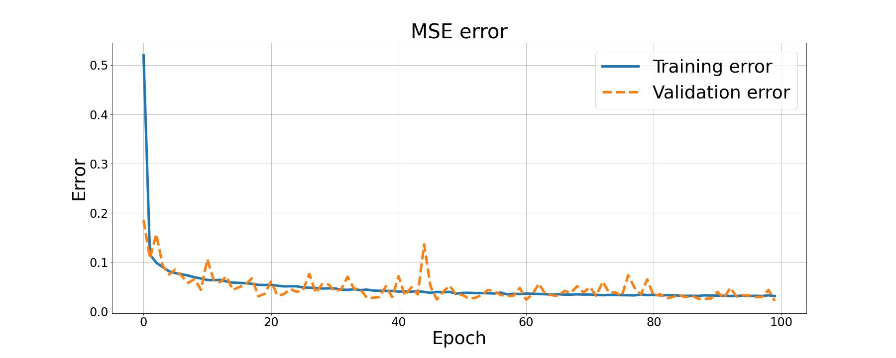
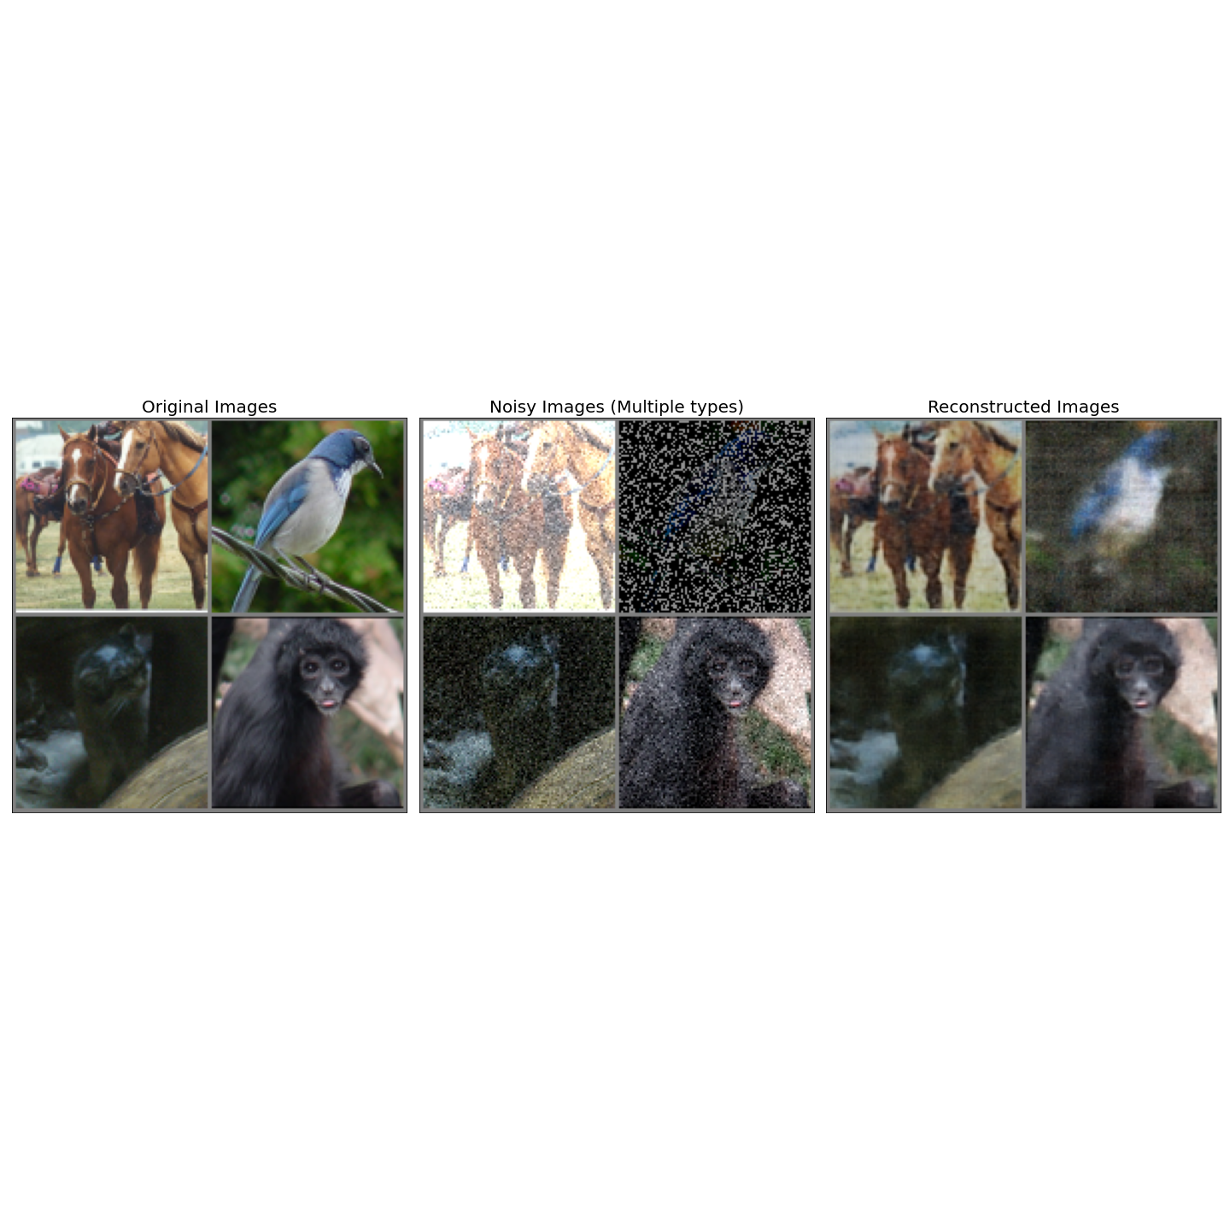
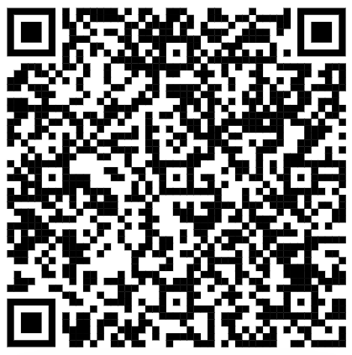

Denoising Autoencoders for Image Quality Improvement
August Leander Høeg (s173944@dtu.dk), Thor Vestergaard Christiansen (s173949@dtu.dk)
DTU Compute, Technical University of Denmark
Introduction
Model
96x96x3
RGB image
Network Architecture
Dataset
At the Danish start-up company, Omhu, the ambition is to use machine learning algorithms to diagnose skin conditions from smartphone images taken by pati-ents. These images however of-ten suffer from noise such as motion blur, over- and underexpo-sure or a combination of different types of noise. By training a de-noising autoencoder to improve the quality of the images, it will be easier to classify and diagnose the patients’ skin conditions from the images.
A Denoising Autoencoder has been selected to improve the quality of the images, as the best results were obtained using this method. A high quality image $X$ is corrupted by applying a transformation to the image that mimics noise and the noisy image $\tilde{X}$ is then for-warded through an encoder $f.$ The encoder reduces the dimensionality of the input to get the latent variable $Z$. Afterwards the latent variable is forwarded through a decoder $g$ and the reconstruction of the high quality image $\hat{X}=g\left(f\left(\tilde{X}\right)\right)$ is then compared to the original image $X$. The reconstruction error (MSE) is computed and the weights of the parameters are updated using the Adam Optimizer. The Denoising Autoencoder consist of a fully convolutional network.
The STL-10 dataset with 8000 training images and 5000 test images of size 96x96x3 was used. The images were divided into 10 classes of equal size.
Results - Quantitative
Dataset | STL-10
# Training images | 8000
# Test images | 5000
Training error | 0.031
Validation error | 0.021
No ise
f
Encoder
Z
g
Decoder
Key contributions:
Image noise functions
Denoising Autoencoder
Results - Qualitative
Conclusion
References
It this project, it has been shown that the denoising au-toencoder is able to remove different types and combi-nations of noise from images from the STL-10 dataset.
[1] O. Ronneberger and P. Fischer and T. Brox ”U-NET: Convoluttional Networks for Biomedical Image Segmentation”, Medical Image Computing and Computer-Assisted Intervention (MICCAI), Volume 9351, Pages 234-241 (2015), Springer
[2] T. Tong et. al. ”Image Super-Resolution Using Dense Skip Connections”, 16th IEEE International Conference on Computer Vision, ICCV 2017, pages 4809-4817 (2017)
[3] Adam Coates, Honglak Lee, Andrew Y. Ng ”An Analysis of Single Layer Networks in Unsupervised Feature Learning”, AISTATS, (2011)
[4] C. Doersch– ”Tutorial on Variational Autoencoders” (2016), Carnegie Mellon/UC Berkeley
Future work
The next step in this pro-cess would be to train the denoising autoencoder on more challenging types of noise and image transfor-mations such as homogra-phy transformations and re-solution enhancement. With these additions, the network could be trained on the da-taset containing images of patients’ skin conditions. If the network denoises the images properly, the images can be correctly diagnosed.
Code and Paper
The code and the paper can be ac-cessed by scan-ning the QR -code
Notes:
1

